Slide 1
UWA Central Receiving
Seattle Campus
February 2026

Slide 2
Agenda
# | Topic | OBJECTIVE
1 | Objectives | Understand why Central Receiving is being deployed
2 | Scope And Approach | What is in and not in scope How will this be deployed
2 | Current State Characteristics | Define key current state operating parameters and results
3 | Target State Characteristics | Communicate central receiving future state operating model and benefits
5 | Next Steps | Our Requests of You

Slide 3
Objectives
Primary Objectives
Deploy Central Receiving capabilities across all UW campuses to achieve:
Category | Primary Objective
Increased Operational Efficiency | One centralized group responsible for physical and systematic receiving, removing the burden from requisition requesters
Improved Financial Controls | Standardized process and documentation, eliminate dependency on ASN auto receipt, reduce aged invoices
Enhanced Visibility | All process steps and documentation visible in Workday from requisition to package delivery
Why Now?
Historically, UWA has operated in a decentralized logistics model which allows all suppliers to ship directly to all buildings, as opposed to having suppliers ship to central receiving locations
Renewed focus for UW to pursue efficiency gains in numerous operational areas of the University
With stabilization and maturity levels rising post-UWFT, optimization of business processes is now more possible

Slide 4












Current State: Operating Model
Suppliers (10K+)
Key Characteristics
All suppliers and / or couriers ship directly to all buildings on all campuses
No standardized practices for physical or systematic receiving
Requires Depts / Units to manually create receipts in Workday for most orders, and manage package slips
High level of courier traffic across each campus
Delays in invoice payments due to receiving related match exceptions
Campus Delivery Locations (~700)

Slide 5
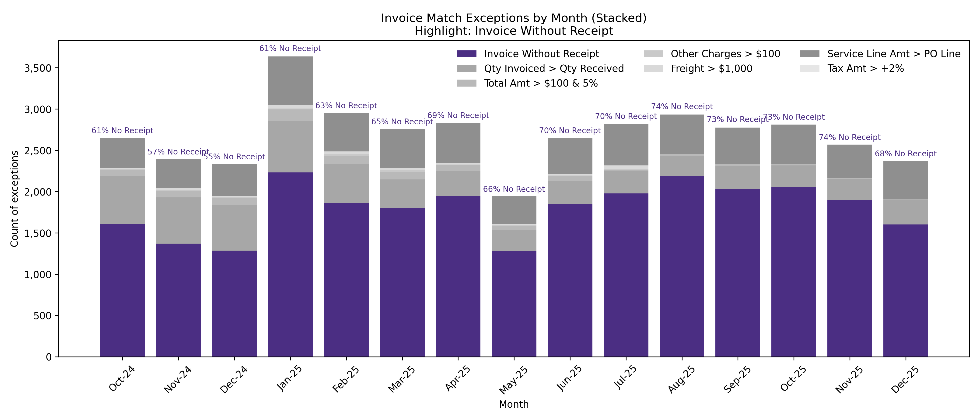
Current State: Results
Results (UW1861 only)
  Receipts in Workday are required to pay an invoice (“3-Way Match”)
  Procure to Pay process requires requisitioners to create these receipts for most orders
  Delayed receipt creation is a significant factor in invoice payment delays, from UWFT go live to today
  Graphic below highlights the persistent level of Invoices possibly delayed based on lack of receipts

Slide 6

Key Target State Features
All suppliers ship directly to the campus receiving depots(s)
Central receiving depots will include one primary depot, plus satellites for buildings with existing docks and select deliveries
Standardized receiving processes and tools across UWA, executed primarily by the C2 team or in concert with the C2 team
The depot physically and systematically receives packages, and delivers “desktop” across campus
Eliminates need for purchase requisitioner to systematically receive product and track packing slips
Provides visible chain of custody evidence in Workday
Reduced aged invoices due to receiving related issues
Improved sustainability and safety due to decreased vehicle traffic on campus
Target State
Suppliers (10K+)
Depots (Multiple)
SEA Campus Receiving Depots
Campus Receiving Hub
Campus Receiving Hubs
Campus Delivery Locations (~700)

Slide 7
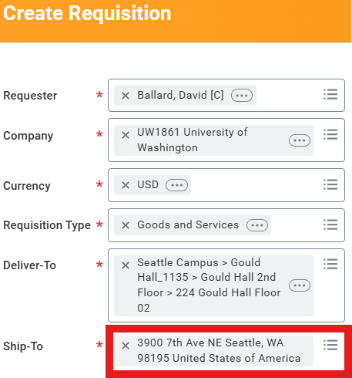
Target State Model: Seattle Wave 1 (April 2026)
Receiving Depot
Gerberding Hall
1704 NE Grant Ln
Student Union Bldg
4001 E Stevens Way NE
Dempsey Hall
4273 E Stevens Way
Gould Hall
3950 University Way NE
SEA Wave 1 Deployment Scope
Bill & Melinda Gates Center for Computer Science & Engineering
Communications Building
Dempsey Hall
Fishery Sciences
Kane Hall
Graves Hall
Gerberding Hall
Gould Hall
Miller Hall
Social Work/Speech and Hearing
Sciences Building
Student Union Building
Existing Deployments
UW Medicine (all locations)
UW Tacoma (3/2026)
Catalog
Suppliers
Non-Catalog
Suppliers
Publication Services Building
3900 7th Ave NE
Deliver to’s will now populate the Pub Svcs ship to address, NOT your typical ship to address.
Your specific deliver to will still print on POs and supplier shipping labels

Slide 8
Scope
Category | In Scope | Out of Scope | Comments
Companies | UW1861 and SOM | All other Workday companies | UW1861 is initial focus. SOM will occur later in the deployment plan
Campuses | Tacoma, Seattle | Bothell
Buildings | All buildings with PO related shipments over the past 24 months | Bldgs with no shipment history + bldgs w/ existing docks | 200 – 250 buildings in scope out of approximately 700 total building locations
Central Receiving Hubs | One: Creative Communications (Publication Services Building) | Existing staffed docks | Buildings with existing staffed docks will be integrated into Central Receiving processes in future phases
Packages | All packages ordered via Workday | Amazon, P-Card, other non-PO methods | POs for live specimens, hazardous materials, gas cylinders and other commodities will initially be handled by exception processes

Slide 9
Approach
Deploy by building, by increasing complexity
Deploy in monthly Waves:
  April: 11 buildings
  May: 20 expected buildings
  Continue until 200 – 250 in scope buildings are completed
Wave selections will be posted 4 – 6 weeks in advance of deployment
Monthly Wave deployment sessions with FPB / C2 to announce and work with selected point(s) of contact on deployment planning

Slide 10
Example Deployment Timeline & Activities
Target deployment: Early April
Multiple interactions with your team between now and deployment to help with change management
Any specific building requirements will be addressed, but need to stay within the guidelines of the program

Slide 11
Summary
Centralized receiving is a common best practice amongst our peers
Proven Solution:
  UW Medicine deployed this same approach during UWFT 2023 at all their locations
  This solution is deployed on the UW Tacoma campus as of March 3rd, 2026
  The technical solution in Workday is already developed and easily migrated to SEA campus buildings
  The operational solution utilizes existing C2 physical facilities, equipment, technology, processes and staff
No additional cost to Departments
Minimal change impact to stakeholders, who will see a reduction in their level of effort in this space

